Slide 1
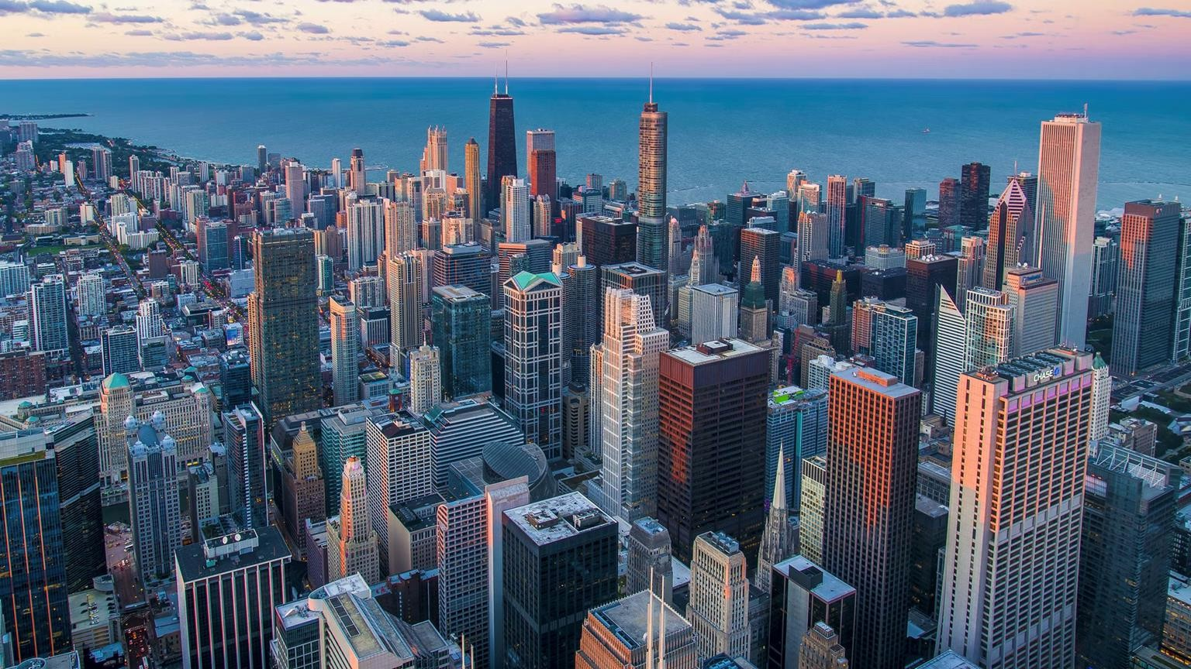

#RintisKarirImpian
Configure Print Settings for Presentations

Slide 2
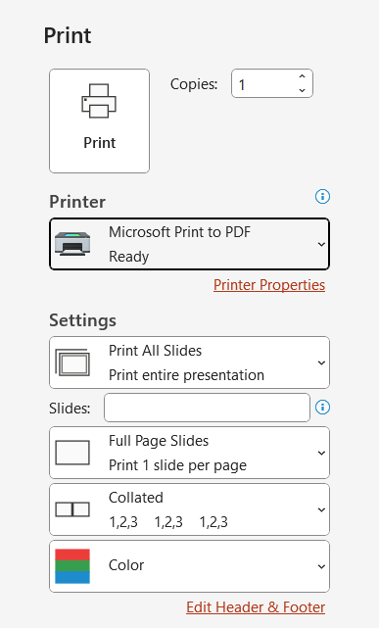

Configure Print Settings for Presentations
Print All or Part of a Presentation
1
Print Notes Page
2
Print Handouts
3
4
Print in Color, Grayscale, or Black and White
#RintisKarirImpian

Slide 3
Configure Print Settings for Presentations
Pembahasan | Penjelasan
Print All or Part of a Presentation | File > Print > Print all slides > OK
Print Notes Page | File > Print > Pilih notes pages > OK
Print Handouts | File > Print > Sesuaikan slide, warna, dll > OK
Print in Color, Grayscale, or Black and White | File > Print > Pilih color, grayscale, atau pure black and white > OK
#RintisKarirImpian

Slide 4
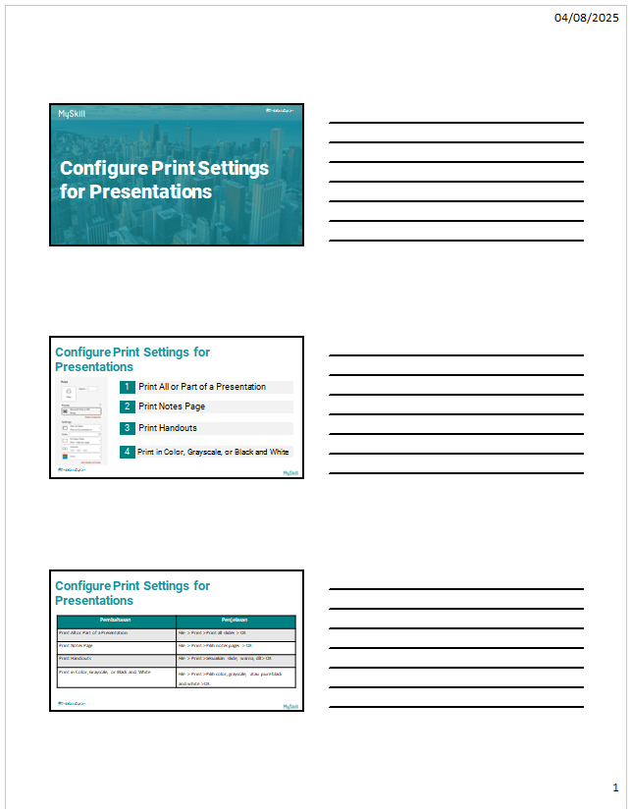
Configure Print Settings for Presentations
#RintisKarirImpian

